Slide 1
무선신호는
어떻게 전달될까?
J103 신승현

Slide 2


< A >
< B >
J103 신승현

Slide 3

< A >
< B >
J103 신승현

Slide 4


< A >
< B >
J103 신승현

Slide 5


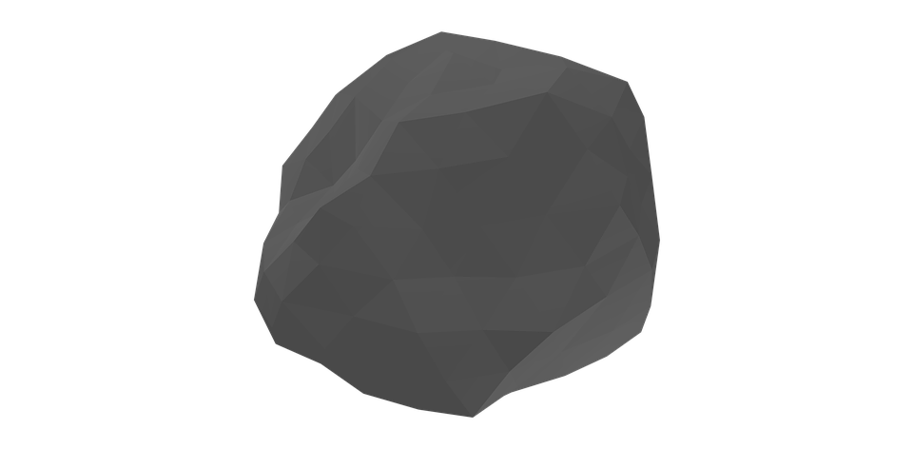
< How To Make Strong Paper >
< Message Signal >
< Carrier Signal >
< Modulated Signal >
J103 신승현

Slide 6
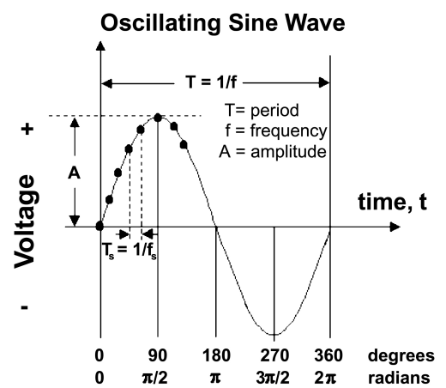
J103 신승현

Slide 7
< Amplitude >
< low >
< high >
J103 신승현

Slide 8
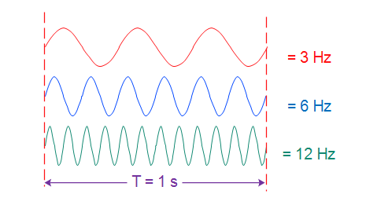
< Frequency >
J103 신승현

Slide 9
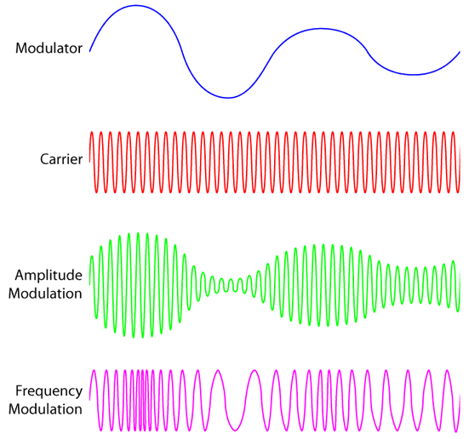
< Message Signal >
< Carrier Signal >
J103 신승현

Slide 10
< AM / FM >
J103 신승현

Slide 11
Amplitude Modulating Frequency Modulating
J103 신승현

Slide 12
< Message Signal >
< AM >
< Carrier Signal >
< Modulated Signal >
J103 신승현

Slide 13
< Message Signal >
< FM >
< Carrier Signal >
< Modulated Signal >
J103 신승현

Slide 14
< A >
< B >
J103 신승현

Slide 15
< A >
< B >
J103 신승현

Slide 16
< A >
< B >
J103 신승현

Slide 17
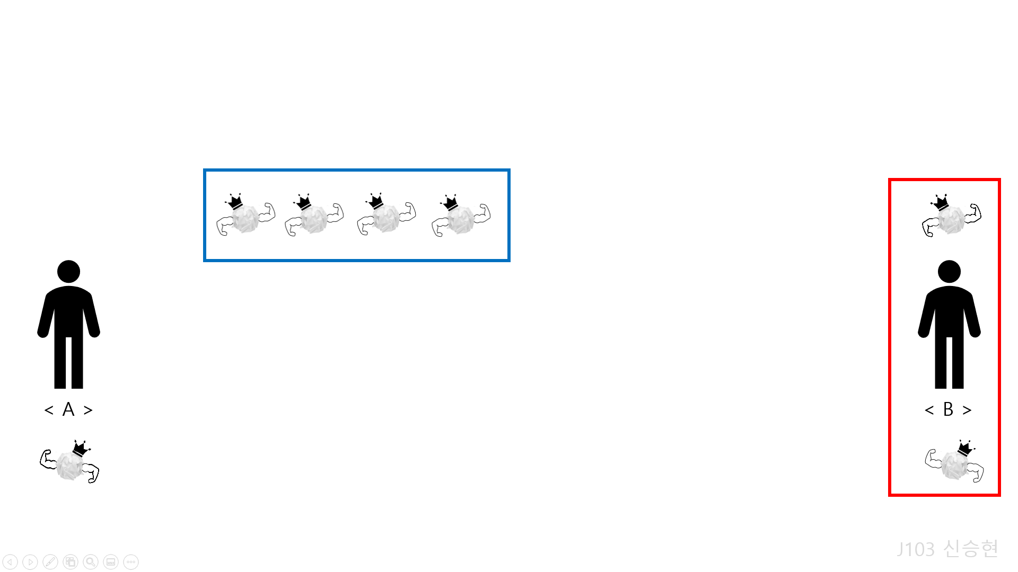

Slide 18



< Duplexing >
AP

Slide 21
< Multiplexing >
F D M
T D M

Slide 22
Frequency Division Multiplexing
10
. . .
0
100
540

Slide 23
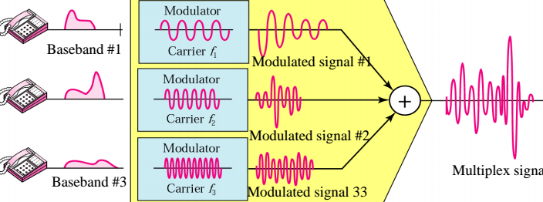
Frequency Division Multiplexing

Slide 24
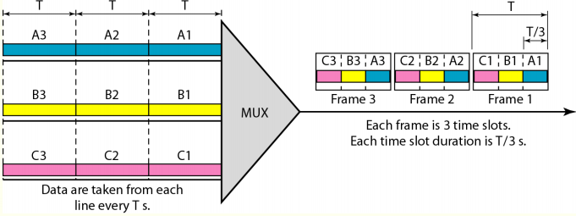
Time Division Multiplexing

Slide 25
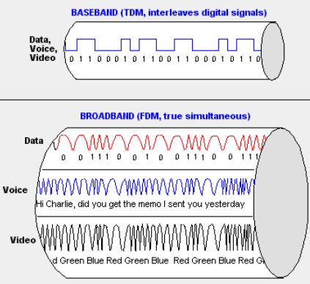

Slide 26
Q & A

Slide 27
Thanks

